Slide 1
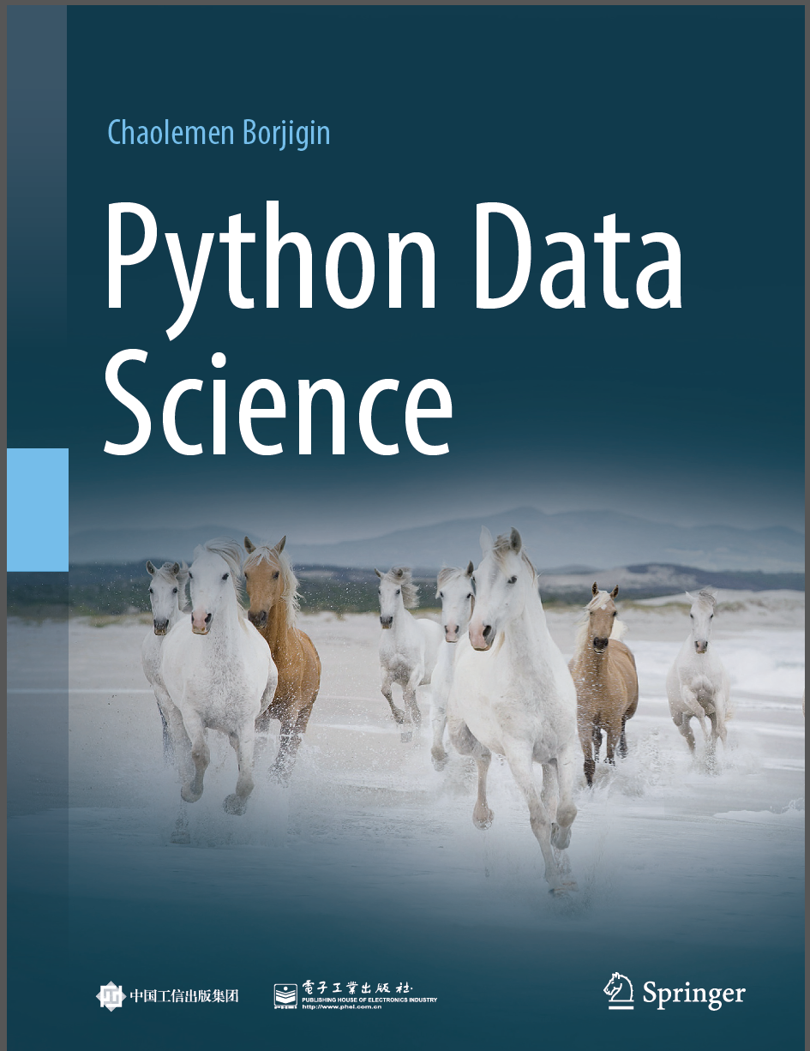
Python Data Science
Chaolemen Borjigin
Renmin University of China
chaolemen@ruc.edu.cn

Slide 2
2.4 Statements
▼ Chapter 2 Basic Python Programming for Data Science
► 2.4 Statements
Chaolemen Borjigin
Renmin University of China
chaolemen@ruc.edu.cn

Slide 3
Summary of this chapter
▼ Chapter 2 Basic Python Programming for Data Science
► 2.4 Statements
2.4.1 Writing a statement in a line
2.4.2 Writing multiple statements in a single line
2.4.3 Splitting a statement into multiple lines
2.4.4 Compound statements
2.4.5 Empty statements

Slide 4
2.4.1 Writing a statement in a line
▼ Chapter 2 Basic Python Programming for Data Science
► 2.4 Statements
In[1]:
i=20
j=30
k=40

Slide 5
2.4.2 Writing multiple statements in a single line
▼ Chapter 2 Basic Python Programming for Data Science
► 2.4 Statements
In[2]:
i=20;j=30;k=40
In[3]:
i;j;k
Out[3]:
40
In[4]:
i,j,k
Out[4]:
(20, 30, 40)

Slide 6
2.4.2 Writing multiple statements in a single line
▼ Chapter 2 Basic Python Programming for Data Science
► 2.4 Statements
In[5]:
print(i;j;k)
File "<ipython-input-5-efd9c261ba8d>", line 1
print(i;j;k)
^
SyntaxError: invalid syntax

Slide 7
2.4.3 Splitting a statement into multiple lines
▼ Chapter 2 Basic Python Programming for Data Science
► 2.4 Statements
In[6]:
print("nin \
hao")
nin hao

Slide 8
2.4.4 Compound statements
▼ Chapter 2 Basic Python Programming for Data Science
► 2.4 Statements
In[7]:
sum=0
for i in range(1,10):
sum=sum+i
print(i)
print(sum)
1
2
3
4
5
6
7
8
9
45

Slide 9
2.4.4 Compound statements
▼ Chapter 2 Basic Python Programming for Data Science
► 2.4 Statements
In[8]:
a = 10
if a > 5:
print("a+1=",a+1)
print("a=",a)
a+1= 11
a= 10

Slide 10
2.4.5 Empty statements
▼ Chapter 2 Basic Python Programming for Data Science
► 2.4 Statements
In[9]:
x=1
y=2
if x>y:
pass
else:
print(y)
2

Slide 11


